Slide 1
Daily Report of Pi Logger system
Hiroshi OKAMOTO.
On 2018-11-09

Slide 2
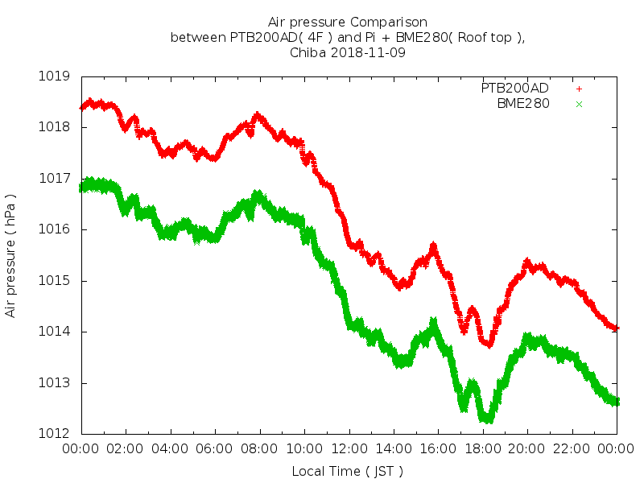
Air Pressure.

Slide 3
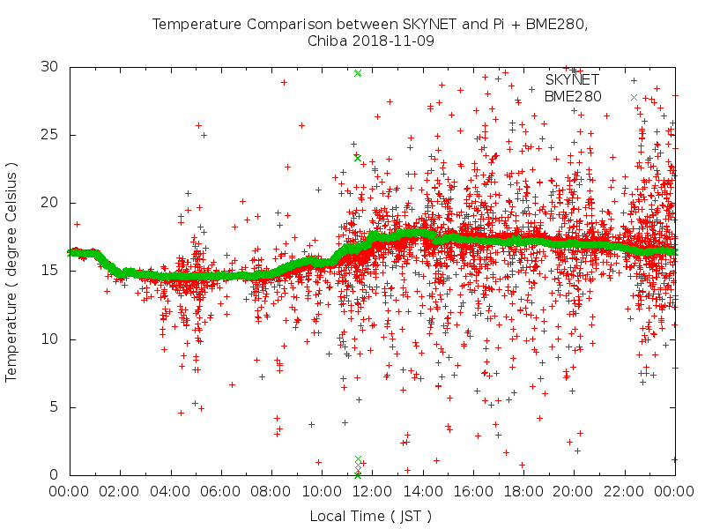
Temperature.

Slide 4
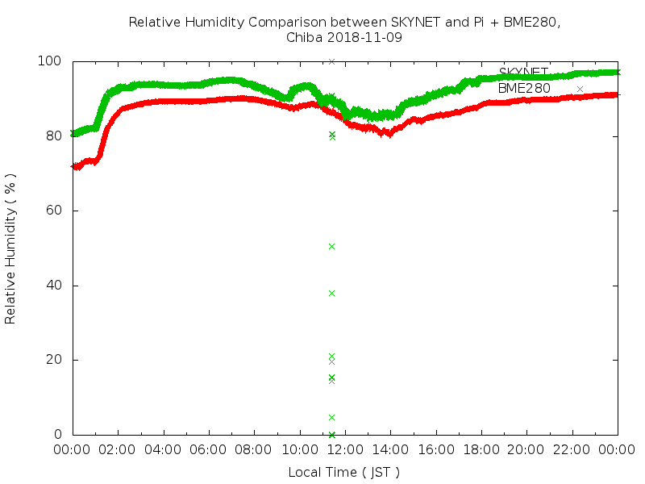
Relative Humidity.

